Slide 1
PGVCL Training
Day-12

Slide 2
Flutter Training for PGVCL Department
Day 12 : Publishing and CI/CD

Slide 3
Overview
Topics We’ll Be Covering For Today
Theory
Continuous Integration and Deployment (CI/CD) in Flutter.
App versioning and handling updates
Practical
Set up a CI/CD pipeline using GitHub Actions or a similar tool.
Publish the app to the Play Store or a test distribution platform

Slide 4
Objectives
Understand Continuous Integration and Deployment (CI/CD) workflows in Flutter.
Learn app versioning and update strategies.
Set up a basic CI/CD pipeline using tools like GitHub Actions.
Publish a Flutter app to the Play Store or test distribution platforms.

Slide 5
What Is CI/CD?
Definition:
Continuous Integration (CI): Automates the process of testing and integrating code changes.
Continuous Deployment (CD): Automates the process of deploying builds to production or testing environments.
Why Use CI/CD?
Efficiency: Reduces manual errors and speeds up development cycles.
Consistency: Ensures high-quality builds across environments.
Scalability: Simplifies workflows as the team size grows.

Slide 6
Key Components of a CI/CD Pipeline
Source Code Repository:
Platforms: GitHub, GitLab, Bitbucket.
Build Automation:
Tools: Flutter build commands (flutter build apk, flutter build ipa).
Testing:
Run unit, widget, and integration tests.
Deployment:
Publish to app stores or distribute internally.

Slide 7
Tools for CI/CD in Flutter
GitHub Actions: Flexible workflows integrated with GitHub.
Bitrise: Flutter-friendly automation with pre-built workflows.
Codemagic: Specialized CI/CD for Flutter.
Jenkins: Open-source and highly customizable.

Slide 8
Tools for Code Generation:
build_runner: Core tool for running code generation scripts.
json_serializable: Generates JSON model classes automatically.
freezed: Creates immutable model classes with minimal boilerplate.

Slide 9
App Versioning and Update Strategies
Specified in pubspec.yaml:
yaml
version: 1.0.0+1
1.0.0: Major, minor, and patch versions.
+1: Build number for internal tracking.
Update Strategies:
Notify users about updates with in-app alerts or Play Store prompts.
Implement Hotfixes for critical issues.

Slide 10
Update Strategies:
Notify users about updates with in-app alerts or Play Store prompts.
Implement Hotfixes for critical issues.

Slide 11
Practical: Setting Up a CI/CD Pipeline
Objective: Automate the build and deployment process using GitHub Actions.
Steps:
Create a Workflow File:
Add .github/workflows/flutter-ci.yml.
Configure Flutter Actions:
Install dependencies, run tests, and build the app.
Automate Deployment:
Publish to Play Store or distribute APK/IPA via Firebase App Distribution.

Slide 12
Publishing to the Play Store
Steps to Publish:
Prepare Your App:
Generate a signed APK or App Bundle.
Test the app thoroughly.
Set Up Play Console:
Create an app listing.
Upload your build and complete store metadata.
Release Your App:
Roll out the app to internal testers or production.

Slide 13
Best Practices for CI/CD and Publishing
Keep Secrets Secure:
Use environment variables for sensitive data (e.g., API keys).
Monitor Builds:
Set up notifications for build failures.
Optimize Build Times:
Cache dependencies and intermediate files.
Plan Rollouts:
Use staged rollouts to limit risk.

Slide 14
Conclusion
CI/CD ensures efficient and reliable app deployment.
App versioning and update strategies enhance user experience.
Automating repetitive tasks allows developers to focus on innovation and quality.

Slide 15
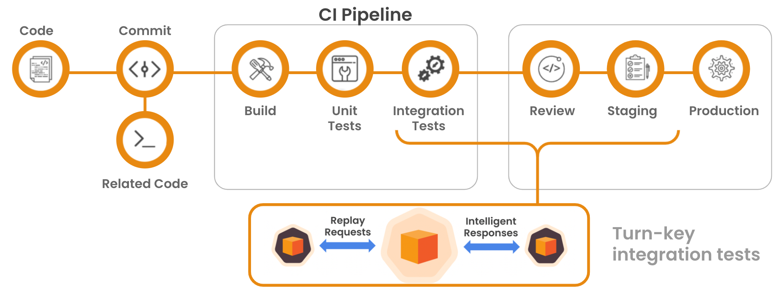

Slide 16
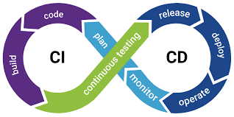

Slide 17
Practical Example
Link
Assignment Example
Create a basic UI with 3 Stateless Widgets and 2 Stateful Widgets

